Slide 1
Atomic Structure and Isotopes

Slide 2
Lesson Objectives
List the relative charges and masses of protons, neutrons and electrons State that the atom has a dense, positively charged nucleus consisting of protons and neutrons, around which move negatively charged electrons. State that an element is identified by its atomic number (Z) which determines the number of electrons in a neutral atom of the element. Define the mass number (A) of an atom as the total number of protons and neutrons in the nucleus of an atom. From the relationship between atomic number and mass number, determine the number of protons, neutrons and electrons in an atom or monatomic ion. Describe and explain the contributions of each of the following scientists to the development of the atomic model: o Dalton o Thomson, o Rutherford, o Bohr o Chadwick Draw labelled diagrams and explain the structure of each of the atomic models associated with the scientists listed above. Draw and label a timeline showing the development of the atomic model. Explain how changes in technology have contributed to the atomic model and our understanding of the atom.
Define isotopes as atoms with the same number of protons and different numbers of neutrons. Explain the existence of isotopes in terms of the neutron content of the nucleus. Give examples of isotopes that have similar chemical properties but different physical properties, such as hydrogen, carbon and cobalt. Describe differences in physical properties of isotopes of the same element, such as hydrogen, carbon and cobalt. Predict the chemical behaviour of an isotope given the properties of another isotope of the same element. Define relative atomic mass (atomic weight) as the ratio of the average mass of the atom to 1/12 the mass of an atom of 12-C. Explain the existence of fractional atomic masses of some elements in terms of the existence of naturally occurring isotopes. Calculate the relative atomic mass given the isotopic mass and relative abundances of the isotopes of an element. Represent different isotopes in the form ^{A}X (IUPAC) or X-A. Calculate relative abundance of an isotope given relative atomic mass and abundance of other isotopes of an element. State and compare the characteristics of homogeneous and heterogeneous substances. Distinguish between pure substances (elements and compounds), homogeneous mixtures and heterogeneous mixtures. Explain the relationship between the identity and relative amounts of substances in a mixture and its properties.

Slide 3
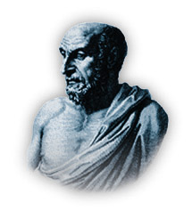
What is “atom”?
Atomos = indivisible
Atomism
The Greek philosopher Democritus (~460 B.C. – 370 B.C.)

Slide 4
These are iron atoms!!
Atomos = indivisible
Continuous division
Iron
Continuous division

Slide 5
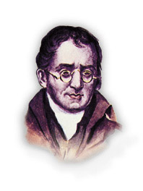
Dalton’s atomic theory
1803 AD John Dalton

Slide 6
Main points of Dalton’s atomic theory
1. All elements are made up of atoms.
Atoms cannot be created, divided into smaller particles, nor destroyed in the chemical process.
A chemical reaction simply changes the way atoms are grouped together.

Slide 7
Main points of Dalton’s atomic theory
3. Atoms of the same element are identical. They have the same mass and chemical properties.
4. Atoms of different elements are different. They have different masses and chemical properties.
5. When atoms of different elements combine to form a compound, they do so in a simple whole number ratio to each other.
Check Point 1-1

Slide 8
Steps to Thomson’s Atomic Model
1876 Goldstein
Discovery of cathode rays from discharge tube experiment.

Slide 9
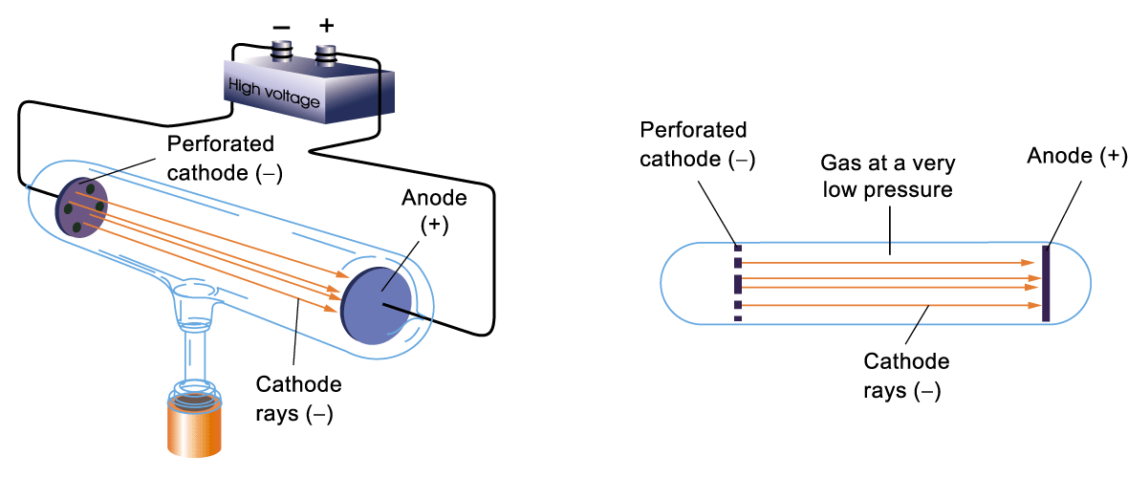
Discovery of Cathode Rays
A beam of rays came out from the cathode and hit the anode
Goldstein called the beam cathode rays

Slide 10
Steps to Thomson’s Atomic Model
1876 Goldstein
Discovery of cathode rays from discharge tube experiment.
1895 Crookes
Cathode rays are negatively charged particles which travelled in straight line. ⇒ electrons

Slide 11
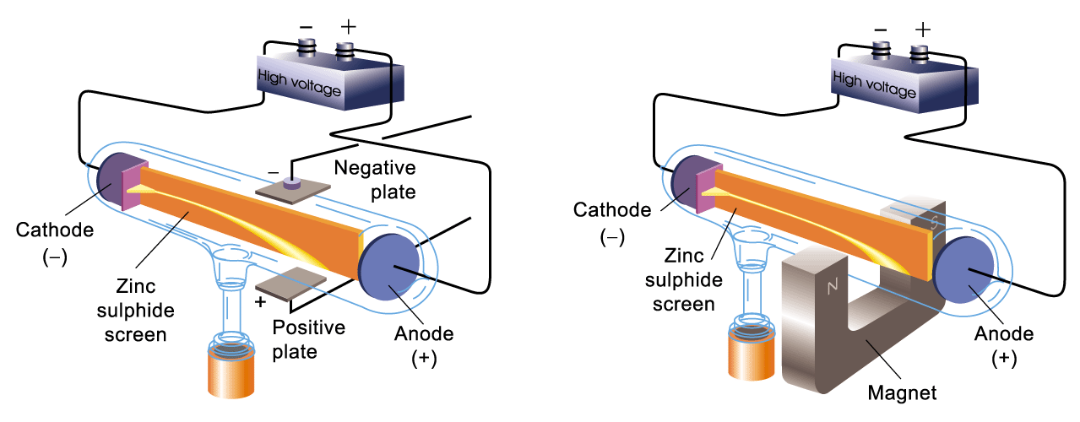
Deflected in the electric field
Deflected in the magnetic field

Slide 12
The beam was composed of negatively charged fast-moving particles.

Slide 13
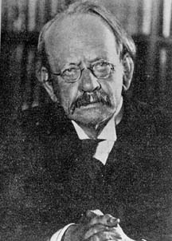
Measurement of the m/e ratio of ‘electron’
1897
J J Thomson (1856-1940)

Slide 14
Measure the mass to charge ratio (m/e) of the particles produced
Independent of the nature of the gas inside the discharge tube
The particles were constituents of all atoms!!
Thomson called the particles ‘electrons’.

Slide 15
Thomson’s atomic model
An atom was a positively charged sphere of low density
The positively charged sphere is balanced electrically by negatively charged electrons
Atom
Electron

Slide 16
How are the particles distributed in an atom?
Most of the mass of the atom was carried by the electrons (>1000 e⁻)
An atom was a positively charged sphere of low density with negatively charged electrons embedded in it like a plum pudding
Positive charge
Electron

Slide 17
How are the particles distributed in an atom?
Like a raisin bun
Positive charge
Electron

Slide 18
How are the particles distributed in an atom?
Experimental evidence : -
Powerful projectiles such as α-particles passes straight through a thin gold foil.
Analogy : -
α-particle vs a thin gold foil
≡ 15-inch canon ball vs a piece of paper

Slide 19
Lesson Objectives
List the relative charges and masses of protons, neutrons and electrons State that the atom has a dense, positively charged nucleus consisting of protons and neutrons, around which move negatively charged electrons. State that an element is identified by its atomic number (Z) which determines the number of electrons in a neutral atom of the element. Define the mass number (A) of an atom as the total number of protons and neutrons in the nucleus of an atom. From the relationship between atomic number and mass number, determine the number of protons, neutrons and electrons in an atom or monatomic ion. Describe and explain the contributions of each of the following scientists to the development of the atomic model: Dalton Thomson o Rutherford, o Bohr o Chadwick Draw labelled diagrams and explain the structure of each of the atomic models associated with the scientists listed above. Draw and label a timeline showing the development of the atomic model. Explain how changes in technology have contributed to the atomic model and our understanding of the atom.
Define isotopes as atoms with the same number of protons and different numbers of neutrons. Explain the existence of isotopes in terms of the neutron content of the nucleus. Give examples of isotopes that have similar chemical properties but different physical properties, such as hydrogen, carbon and cobalt. Describe differences in physical properties of isotopes of the same element, such as hydrogen, carbon and cobalt. Predict the chemical behaviour of an isotope given the properties of another isotope of the same element. Define relative atomic mass (atomic weight) as the ratio of the average mass of the atom to 1/12 the mass of an atom of 12-C. Explain the existence of fractional atomic masses of some elements in terms of the existence of naturally occurring isotopes. Calculate the relative atomic mass given the isotopic mass and relative abundances of the isotopes of an element. Represent different isotopes in the form ^{A}X (IUPAC) or X-A. Calculate relative abundance of an isotope given relative atomic mass and abundance of other isotopes of an element. State and compare the characteristics of homogeneous and heterogeneous substances. Distinguish between pure substances (elements and compounds), homogeneous mixtures and heterogeneous mixtures. Explain the relationship between the identity and relative amounts of substances in a mixture and its properties.

Slide 20
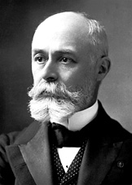
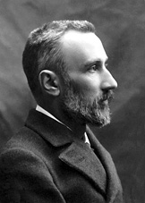
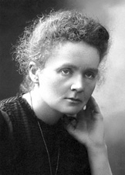
Steps to Rutherford’s Atomic Model
Nobel laureates, Physics, 1903
Becquerel
Pierre Curie
Marie Curie

Slide 21
Steps to Rutherford’s Atomic Model
1896 Becquerel
1st discovery of radioactive substance.
(an uranium salt)

Slide 22
Steps to Rutherford’s Atomic Model
1898 Pierre & Marie Curie
Radioactive polonium and radium were isolated
1g from 500 Kg pitchblende

Slide 23
The Curie Family
Pierre & Marie Curie
Nobel laureate, Physics, 1903
Marie Curie
Nobel laureate, Chemistry, 1911
Federic Joliet & Irene Joliet-Curie
Nobel laureate, Chemistry, 1935

Slide 24
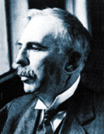
Steps to Rutherford’s Atomic Model
1899 Rutherford
(Nobel laureate, Physics, 1908)
Discovery of α and β radiations.
α radiation → He²⁺
β radiation → e⁻

Slide 25
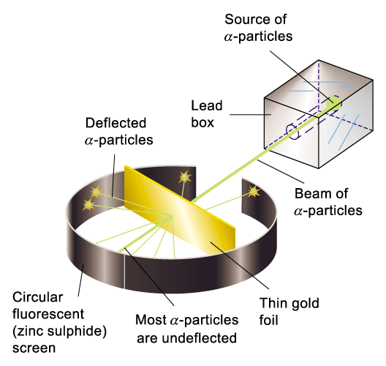
A thin gold foil was bombarded with a beam of fast-moving α-particles (+ve charged)
Observation:
most α-particles passed through the foil without deflection
very few α-particles were scattered or rebounded back

Slide 26
It was quite the most incredible event that has ever happened to me in my life.
It was almost as incredible as if you fired a 15-inch shell at a piece of tissue paper and it came back and hit you.

Slide 27
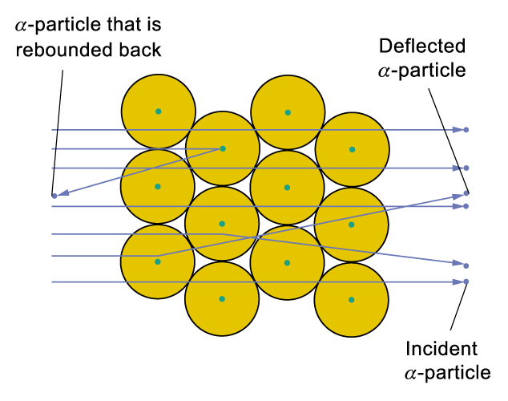
Interpretation of the experimental results
Nucleus is positively charged because it repels the positively charged alpha particles.

Slide 28
Interpretation of the experimental results
Nucleus occupies a very small space (10⁻¹² of size of atom) because very few α particles are deflected.

Slide 29
Interpretation of the experimental results
The radius of an atom is about 20,000 times that of the nucleus. Thus, if we imagine a large football stadium as being the whole atom, then the nucleus would be about the size of a peanut.

Slide 30
Interpretation of the experimental results
Nucleus is relatively massive and highly charged because of the large deflection.

Slide 31
Interpretation of the experimental results
Number of positive charges in each nucleus can be calculated from experimental results
⇒ Presence of protons in nucleus

Slide 32
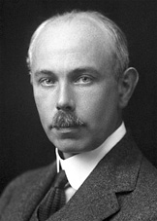
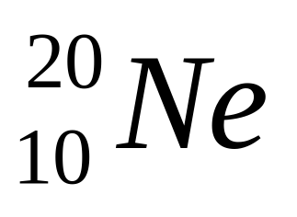
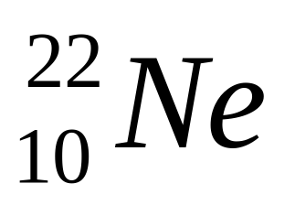
Steps to Chadwick’s Atomic Model
1919 F. W. Aston
(Nobel laureate, Chemistry, 1922)
Isotopes of Neon were discovered using mass spectrometry

Slide 33
Steps to Chadwick’s Atomic Model
1920 Rutherford
Postulated the presence of neutrons in the nucleus

Slide 34
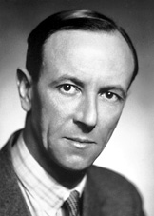
Steps to Chadwick’s Atomic Model
James Chadwick
(Nobel laureate, Physics, 1935)
Discovery of the neutron

Slide 35
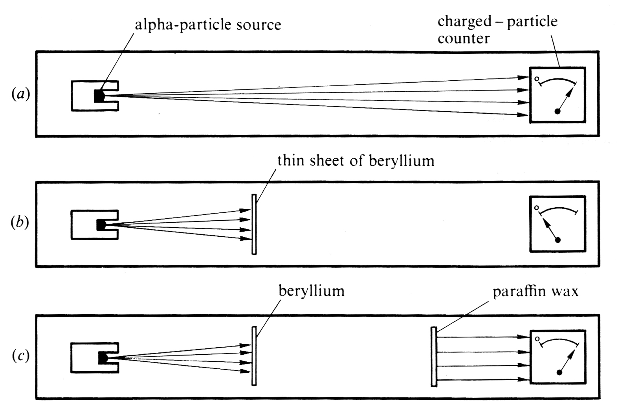
Chadwick’s Experiments

Slide 36
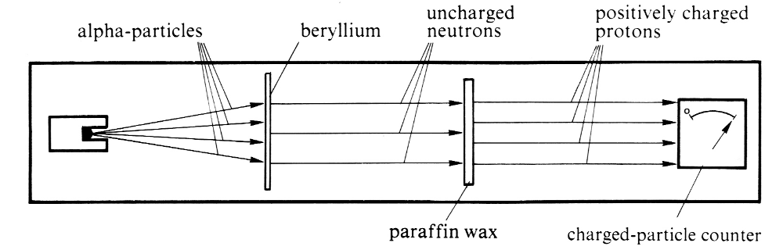
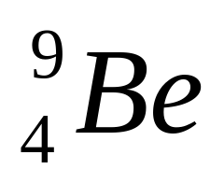
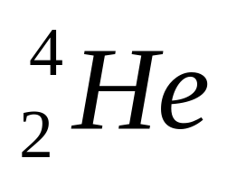
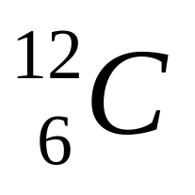
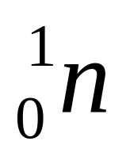
Steps to Chadwick’s Atomic Model
Interpretation : -
+
+

Slide 37
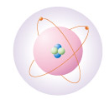
Chadwick’s atomic model
Proton
Electron
Neutron
Check Point 1-2

Slide 38
Lesson Objectives
List the relative charges and masses of protons, neutrons and electrons State that the atom has a dense, positively charged nucleus consisting of protons and neutrons, around which move negatively charged electrons. State that an element is identified by its atomic number (Z) which determines the number of electrons in a neutral atom of the element. Define the mass number (A) of an atom as the total number of protons and neutrons in the nucleus of an atom. From the relationship between atomic number and mass number, determine the number of protons, neutrons and electrons in an atom or monatomic ion. Describe and explain the contributions of each of the following scientists to the development of the atomic model: Dalton Thomson Rutherford, o Bohr Chadwick Draw labelled diagrams and explain the structure of each of the atomic models associated with the scientists listed above. Draw and label a timeline showing the development of the atomic model. Explain how changes in technology have contributed to the atomic model and our understanding of the atom.
Define isotopes as atoms with the same number of protons and different numbers of neutrons. Explain the existence of isotopes in terms of the neutron content of the nucleus. Give examples of isotopes that have similar chemical properties but different physical properties, such as hydrogen, carbon and cobalt. Describe differences in physical properties of isotopes of the same element, such as hydrogen, carbon and cobalt. Predict the chemical behaviour of an isotope given the properties of another isotope of the same element. Define relative atomic mass (atomic weight) as the ratio of the average mass of the atom to 1/12 the mass of an atom of 12-C. Explain the existence of fractional atomic masses of some elements in terms of the existence of naturally occurring isotopes. Calculate the relative atomic mass given the isotopic mass and relative abundances of the isotopes of an element. Represent different isotopes in the form ^{A}X (IUPAC) or X-A. Calculate relative abundance of an isotope given relative atomic mass and abundance of other isotopes of an element. State and compare the characteristics of homogeneous and heterogeneous substances. Distinguish between pure substances (elements and compounds), homogeneous mixtures and heterogeneous mixtures. Explain the relationship between the identity and relative amounts of substances in a mixture and its properties.

Slide 39
Activity
Create a timeline demonstrating the
development of the atomic model.
You must include:
A drawing of the atomic model at each stage of development
The technology found at each stage
Neil’s bohr is another contributor to the atomic model.
Research him and include this in your model.

Slide 40
Lesson Objectives
List the relative charges and masses of protons, neutrons and electrons State that the atom has a dense, positively charged nucleus consisting of protons and neutrons, around which move negatively charged electrons. State that an element is identified by its atomic number (Z) which determines the number of electrons in a neutral atom of the element. Define the mass number (A) of an atom as the total number of protons and neutrons in the nucleus of an atom. From the relationship between atomic number and mass number, determine the number of protons, neutrons and electrons in an atom or monatomic ion. Describe and explain the contributions of each of the following scientists to the development of the atomic model: Dalton Thomson Rutherford, Bohr Chadwick Draw labelled diagrams and explain the structure of each of the atomic models associated with the scientists listed above. Draw and label a timeline showing the development of the atomic model. Explain how changes in technology have contributed to the atomic model and our understanding of the atom.
Define isotopes as atoms with the same number of protons and different numbers of neutrons. Explain the existence of isotopes in terms of the neutron content of the nucleus. Give examples of isotopes that have similar chemical properties but different physical properties, such as hydrogen, carbon and cobalt. Describe differences in physical properties of isotopes of the same element, such as hydrogen, carbon and cobalt. Predict the chemical behaviour of an isotope given the properties of another isotope of the same element. Define relative atomic mass (atomic weight) as the ratio of the average mass of the atom to 1/12 the mass of an atom of 12-C. Explain the existence of fractional atomic masses of some elements in terms of the existence of naturally occurring isotopes. Calculate the relative atomic mass given the isotopic mass and relative abundances of the isotopes of an element. Represent different isotopes in the form ^{A}X (IUPAC) or X-A. Calculate relative abundance of an isotope given relative atomic mass and abundance of other isotopes of an element. State and compare the characteristics of homogeneous and heterogeneous substances. Distinguish between pure substances (elements and compounds), homogeneous mixtures and heterogeneous mixtures. Explain the relationship between the identity and relative amounts of substances in a mixture and its properties.

Slide 41
Sub-atomic Particles

Slide 42
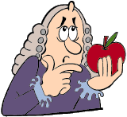
Sub-atomic particles
3 kinds of sub-atomic particles:
Protons
Neutrons
Electrons
Inside the condensed nucleus
Moving around the nucleus
Let's Think 1

Slide 43
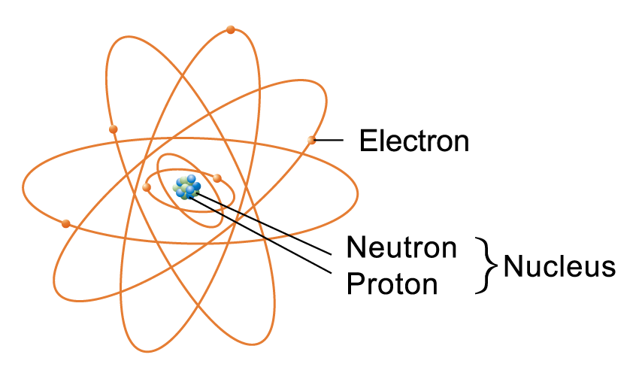
A carbon-12 atom

Slide 44
Characteristics of sub-atomic particles
Sub-atomic particle | Proton | Neutron | Electron
Symbol | p or | n or | e⁻ or
Location in atom | Nucleus | Nucleus | Surrounding the nucleus
Actual charge (C) | 1.6 × 10⁻⁹ | 0 | 1.6 x 10⁻⁹
Relative charge | +1 | 0 | -1
Actual mass (g) | 1.7 × 10⁻²⁴ | 1.7 × 10⁻²⁴ | 9.1 × 10⁻²⁸
Approximate relative mass (a.m.u.) | 1 | 1 | 0
1
1
0
H
n
e
1
0
-1

Slide 45



1 a.m.u. = 1/12 of the mass of a C-12 atom
One C-12 atom has 6 p, 6n and 6e⁻
mass of e⁻ can be ignored
mass of a C-12 atom ≈ 6p + 6n
mass of p ≈ mass of n
mass of a C-12 atom ≈ 6p + 6n ≈ 12p ≈ 12n
mass of p ≈ mass of n ≈ 1 a.m.u.

Slide 46
Lesson Objectives
List the relative charges and masses of protons, neutrons and electrons State that the atom has a dense, positively charged nucleus consisting of protons and neutrons, around which move negatively charged electrons. State that an element is identified by its atomic number (Z) which determines the number of electrons in a neutral atom of the element. Define the mass number (A) of an atom as the total number of protons and neutrons in the nucleus of an atom. From the relationship between atomic number and mass number, determine the number of protons, neutrons and electrons in an atom or monatomic ion. Describe and explain the contributions of each of the following scientists to the development of the atomic model: Dalton Thomson Rutherford, Bohr Chadwick Draw labelled diagrams and explain the structure of each of the atomic models associated with the scientists listed above. Draw and label a timeline showing the development of the atomic model. Explain how changes in technology have contributed to the atomic model and our understanding of the atom.
Define isotopes as atoms with the same number of protons and different numbers of neutrons. Explain the existence of isotopes in terms of the neutron content of the nucleus. Give examples of isotopes that have similar chemical properties but different physical properties, such as hydrogen, carbon and cobalt. Describe differences in physical properties of isotopes of the same element, such as hydrogen, carbon and cobalt. Predict the chemical behaviour of an isotope given the properties of another isotope of the same element. Define relative atomic mass (atomic weight) as the ratio of the average mass of the atom to 1/12 the mass of an atom of 12-C. Explain the existence of fractional atomic masses of some elements in terms of the existence of naturally occurring isotopes. Calculate the relative atomic mass given the isotopic mass and relative abundances of the isotopes of an element. Represent different isotopes in the form ^{A}X (IUPAC) or X-A. Calculate relative abundance of an isotope given relative atomic mass and abundance of other isotopes of an element. State and compare the characteristics of homogeneous and heterogeneous substances. Distinguish between pure substances (elements and compounds), homogeneous mixtures and heterogeneous mixtures. Explain the relationship between the identity and relative amounts of substances in a mixture and its properties.

Slide 47
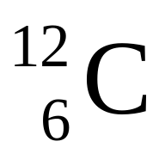
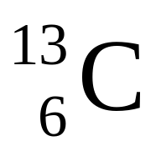
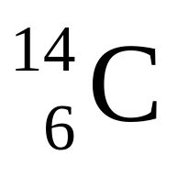
Express the masses of the following isotopes in a.m.u..
12
~13 ~14

Slide 48
Atomic Number, Mass Number and Isotopes

Slide 49

Atomic number
The atomic number (Z) of an element is the number of protons contained in the nucleus of the atom.
Atoms are electrically neutral
Atomic number
Number of protons
Number of electrons
=
=

Slide 50
Mass number
The mass number (A) of an atom is the sum of the number of protons and neutrons in the nucleus.
Mass number
Number of protons
Number of neutrons
=
+
Number of neutrons = Mass number – Atomic number

Slide 51
Isotopes
Isotopes are atoms of the same element with the same number of protons but different numbers of neutrons. Or
Isotopes are atoms of the same element with the same atomic number but different mass numbers

Slide 52
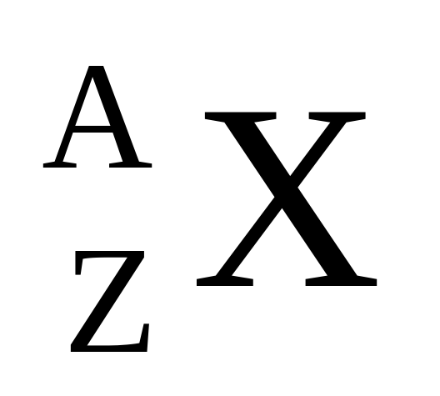
Notation for an isotope
Mass number
Symbol of the element
Atomic number

Slide 53
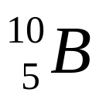
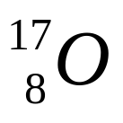
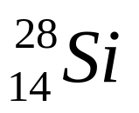
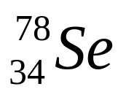
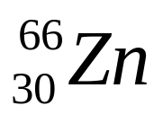
Atomic number
Mass number
No. of electrons
No. of neutrons
Notation
Number of protons
5
10
8
8
9
28
14
10
12
78
44
66
30

Slide 54
Atomic number
Mass number
No. of electrons
No. of neutrons
Notation
Number of protons
5
10
5
5
5
8
17
8
8
9
14
28
14
14
14
10
22
10
10
12
34
78
34
34
44
30
66
30
30
36

Slide 55
Lesson Objectives
List the relative charges and masses of protons, neutrons and electrons State that the atom has a dense, positively charged nucleus consisting of protons and neutrons, around which move negatively charged electrons. State that an element is identified by its atomic number (Z) which determines the number of electrons in a neutral atom of the element. Define the mass number (A) of an atom as the total number of protons and neutrons in the nucleus of an atom. From the relationship between atomic number and mass number, determine the number of protons, neutrons and electrons in an atom or monatomic ion. Describe and explain the contributions of each of the following scientists to the development of the atomic model: Dalton Thomson Rutherford, Bohr Chadwick Draw labelled diagrams and explain the structure of each of the atomic models associated with the scientists listed above. Draw and label a timeline showing the development of the atomic model. Explain how changes in technology have contributed to the atomic model and our understanding of the atom.
Define isotopes as atoms with the same number of protons and different numbers of neutrons. Explain the existence of isotopes in terms of the neutron content of the nucleus. Give examples of isotopes that have similar chemical properties but different physical properties, such as hydrogen, carbon and cobalt. Describe differences in physical properties of isotopes of the same element, such as hydrogen, carbon and cobalt. Predict the chemical behaviour of an isotope given the properties of another isotope of the same element. Define relative atomic mass (atomic weight) as the ratio of the average mass of the atom to 1/12 the mass of an atom of 12-C. Explain the existence of fractional atomic masses of some elements in terms of the existence of naturally occurring isotopes. Calculate the relative atomic mass given the isotopic mass and relative abundances of the isotopes of an element. Represent different isotopes in the form ^{A}X (IUPAC) or X-A. Calculate relative abundance of an isotope given relative atomic mass and abundance of other isotopes of an element. State and compare the characteristics of homogeneous and heterogeneous substances. Distinguish between pure substances (elements and compounds), homogeneous mixtures and heterogeneous mixtures. Explain the relationship between the identity and relative amounts of substances in a mixture and its properties.

Slide 56
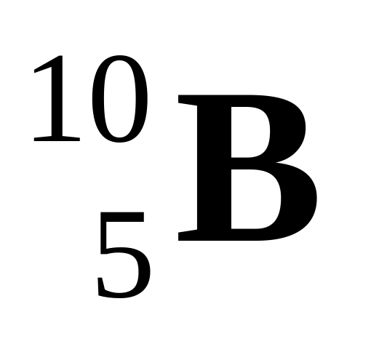
A boron isotope has a relative mass of ~10 a.m.u.
Give the isotopic notation.

Slide 57
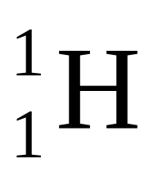
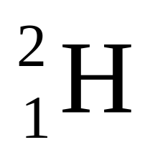
Discovery of isotopes by mass spectrometry
What is the difference in mass between the two isotopes of hydrogen ?
1 a.m.u.
= 1.7 × 10⁻²⁴ g
= 0.0000000000000000000000017 g
No balance is accurate enough to distinguish this difference

Slide 58
What is the difference in mass between the two isotopes of hydrogen ?
What is the relative abundances of the two isotopes of hydrogen ?
99.8% 0.02%
Both tasks can be accomplished with a mass spectrometer !!

Slide 59
Relative isotopic mass
The relative isotopic mass of a particular isotope of an element is the relative mass of one atom of that isotope on the ¹²C = 12.000 scale.

Slide 60
Relative molecular mass
The relative molecular mass is the relative mass of a molecule on the carbon-12 scale.
Relative molecular mass can be determined by mass spectrometer directly.

Slide 61
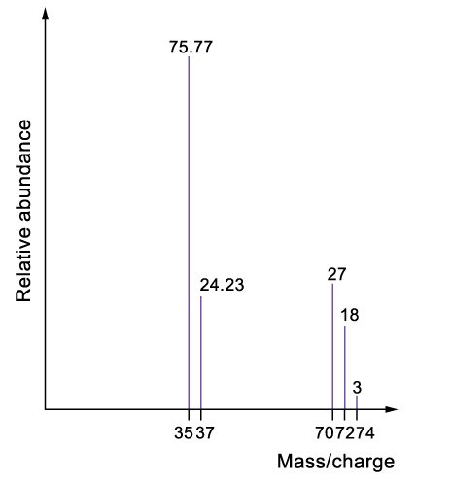
Mass spectrum of Cl₂:
The peaks with higher m/e ratio correspond to molecular ions
Fragmentation of molecules always occurs during the ionization process.
Cl₂(g) → Cl(g) + Cl(g)

Slide 62
Mass spectrum of Cl₂:
The scale has been enlarged for these two peaks.

Slide 63
Complete the following table
m/e ratio | Corresponding ion
35
37
70
72
74
³⁵Cl⁺
³⁷Cl⁺
[³⁵Cl-³⁵Cl]⁺
[³⁵Cl-³⁷Cl]⁺
[³⁷Cl-³⁷Cl]⁺

Slide 64
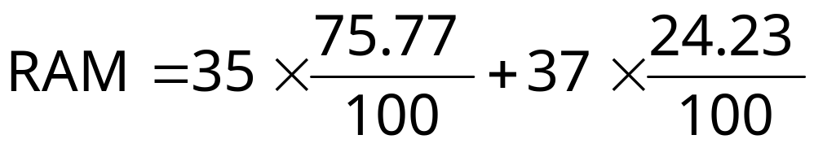
What is the relative atomic mass of Cl?
The relative abundances of Cl-35 and Cl-37 are 75.77 and 24.23 respectively
= 35.48

Slide 65
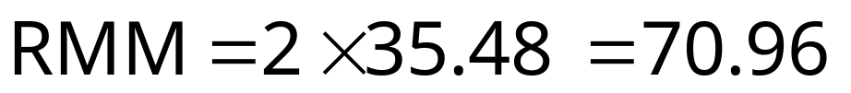
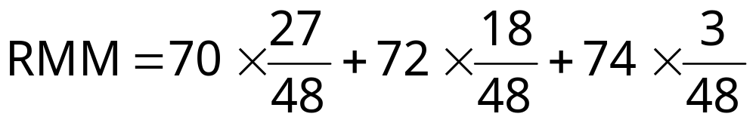
What is the relative molecular mass of Cl₂ ?
Method 1
Method 2
= 71

Slide 66
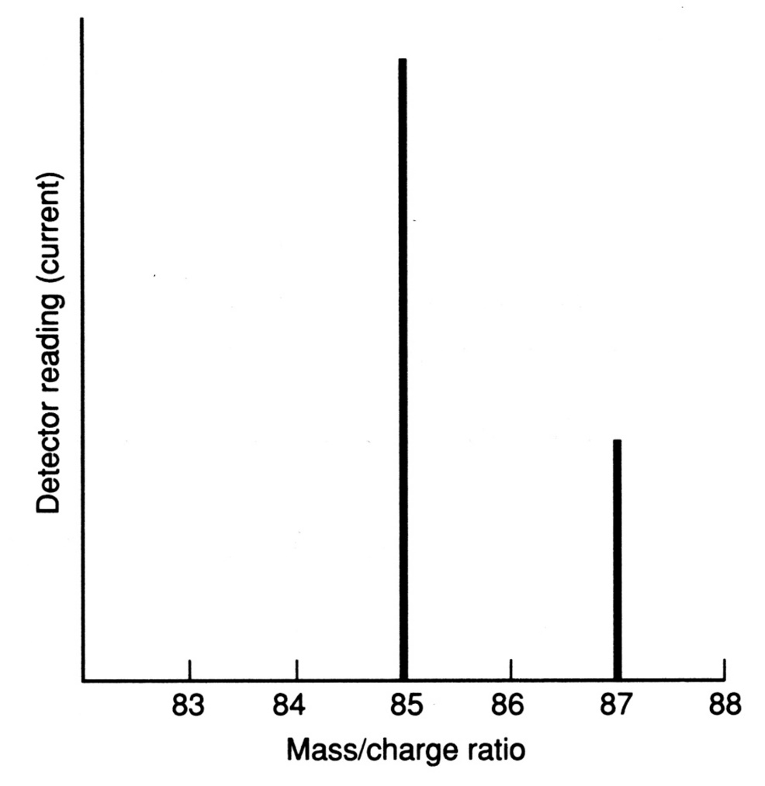
Mass spectrum of Rb:
Y-axis :-
Relative abundance,
Ion intensity, or
Detector current

Slide 67
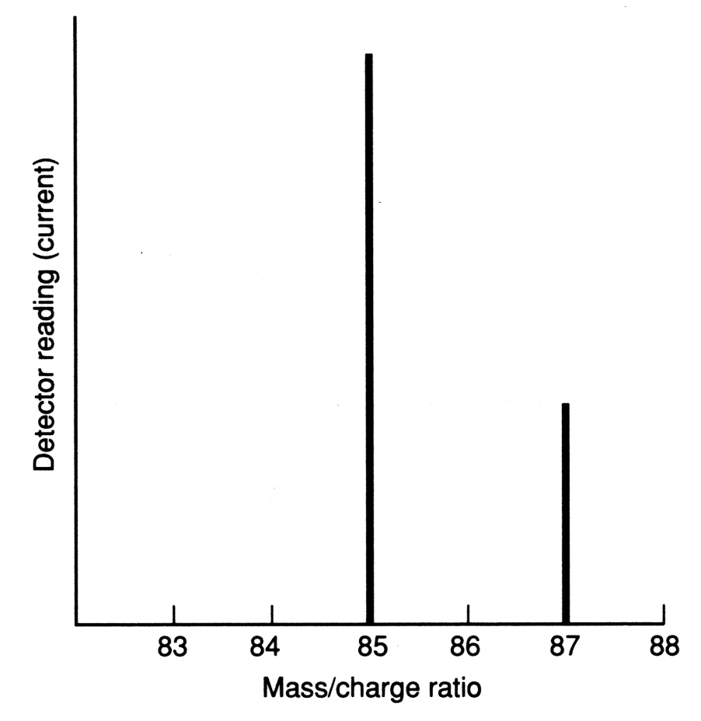
Q.1 Determine the relative atomic mass
72.12%
Relative atomic mass of Rb
= (85 × 72.12%) + (87 × 27.88%)
= 85.56
27.88%

Slide 68
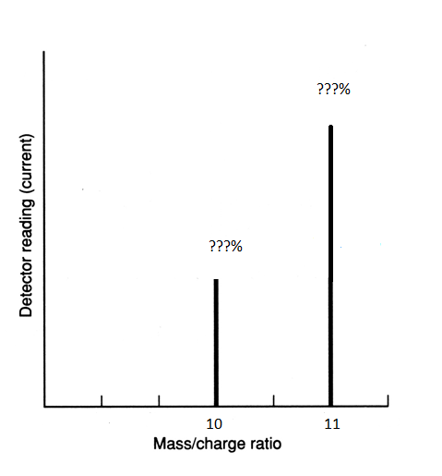
Q.2 Determine the relative abundancies from a relative atomic mass of two known isotopes.
Relative atomic mass of B = 10.8
Two isotopes ¹⁰B & ¹¹B.
Both isotopes have to account for 100% of all elements…
So let y be the unknown abundance:
10.8 = (10 x y) + (11 x (1-y))
10.8 = 10y + 11 – 11y
-0.2 = -y
y = 0.2 = 20% for isotope 10.
So… 80% for isotope 11.

Slide 69
Lesson Objectives
List the relative charges and masses of protons, neutrons and electrons State that the atom has a dense, positively charged nucleus consisting of protons and neutrons, around which move negatively charged electrons. State that an element is identified by its atomic number (Z) which determines the number of electrons in a neutral atom of the element. Define the mass number (A) of an atom as the total number of protons and neutrons in the nucleus of an atom. From the relationship between atomic number and mass number, determine the number of protons, neutrons and electrons in an atom or monatomic ion. (can re-cap quick or do it in ionic bonding) Describe and explain the contributions of each of the following scientists to the development of the atomic model: Dalton Thomson Rutherford, Bohr Chadwick Draw labelled diagrams and explain the structure of each of the atomic models associated with the scientists listed above. Draw and label a timeline showing the development of the atomic model. Explain how changes in technology have contributed to the atomic model and our understanding of the atom.
Define isotopes as atoms with the same number of protons and different numbers of neutrons. Explain the existence of isotopes in terms of the neutron content of the nucleus. Give examples of isotopes that have similar chemical properties but different physical properties, such as hydrogen, carbon and cobalt. Describe differences in physical properties of isotopes of the same element, such as hydrogen, carbon and cobalt. Predict the chemical behaviour of an isotope given the properties of another isotope of the same element.- THERE AREN’T ANY JUST IT CAN BE RADIOACTIVE (DETECTABLE) OR THE SLIGHTLY HEAVIER. Define relative atomic mass (atomic weight) as the ratio of the average mass of the atom to 1/12 the mass of an atom of 12-C. Explain the existence of fractional atomic masses of some elements in terms of the existence of naturally occurring isotopes. You need to … Calculate the relative atomic mass given the isotopic mass and relative abundances of the isotopes of an element. Represent different isotopes in the form ^{A}X (IUPAC) or X-A. Calculate relative abundance of an isotope given relative atomic mass and abundance of other isotopes of an element. State and compare the characteristics of homogeneous and heterogeneous substances. Distinguish between pure substances (elements and compounds), homogeneous mixtures and heterogeneous mixtures. Explain the relationship between the identity and relative amounts of substances in a mixture and its properties.

Slide 70
Isotopes Questions
You now need to achieve the final lesson objectives in which you need to demonstrate understanding.
Complete the “Isotopes worksheet” followed by the remaining questions on this PowerPoint.
Also complete Lucarelli :
Set 2 Q6-8 & 10-13 , 15 , 16

Slide 71


Back
What does the word “atom” literally mean?
Which point of Dalton’s atomic theory is based on the law of conservation of mass proposed by Lavoisier in 1774 which states that matter is neither created nor destroyed in the course of a chemical reaction?
Which point of Dalton’s atomic theory is based on the law of constant proportion proposed by Proust in 1799 which states that all pure samples of the same chemical compound contain the same elements combined together in the same proportions by mass?
(a) Indivisible
(b) Atoms can neither be created nor destroyed.
Answer
(c) Atoms of different elements combine to form a compound. The numbers of various atoms combined bear a simple whole number ratio to each other.

Slide 72
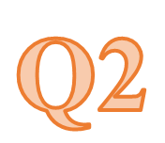
Back
Atoms were found to be divisible. What names were given to the particles found inside the atoms?
Give the most important point of the following experiments:
(i) E. Goldstein’s gas discharge tube experiment;
(ii) J. J. Thomson’s cathode ray tube experiment;
(iii) E. Rutherford’s gold foil scattering experiment.
(a) Electron, proton and neutron
(b) (i) Discovery of cathode rays
(ii) Discovery of electrons
(iii) Discovery of nucleus in atoms
Answer

Slide 73

Hint slide No. :
The identity of an element is determined by the number of which sub-atomic particle?
Answer
The identity of an element is determined by the number of protons in its atomic nucleus.
Back

Slide 74

Hint slide No. :
Back
Which part of the atom accounts for almost all the mass of that atom?
(b) The mass of which sub-atomic particle is often assumed to be zero?
(a) Nucleus
(b) Electron
Answer

Slide 75

Hint slide No. :
Are there any sub-atomic particles other than protons, neutrons and electrons?
Answer
Other than the three common types of sub-atomic particles (proton, neutron and electron), there are also some sub-atomic particles called positron (anti-electron) and quark.
Back

Slide 76

Hint slide No. :
If bromine has two isotopes, ⁷⁹Br and ⁸¹Br, how many physically distinguishable combinations of Br atoms are there in Br₂?
⁷⁹Br—⁷⁹Br
⁷⁹Br—⁸¹Br
⁸¹Br—⁸¹Br
They have different molecular masses and thus have different density
Back

Slide 77


Hint slide No. :
Back
Write the symbol for the atom that has an atomic number of 11 and a mass number of 23. How many protons, neutrons and electrons does this atom have?
Answer
, 11 protons, 12 neutrons, 11 electrons.

Slide 78

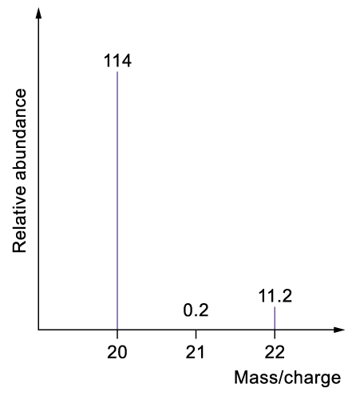
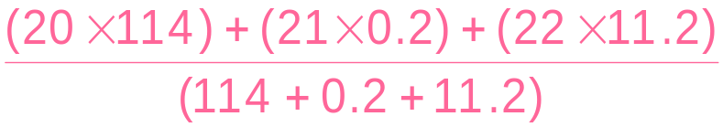
Hint slide No. :
Back
The mass spectrum of neon is given below. Determine the relative atomic mass of neon.
Relative atomic mass of neon
=
= 20.18
Answer

Slide 79

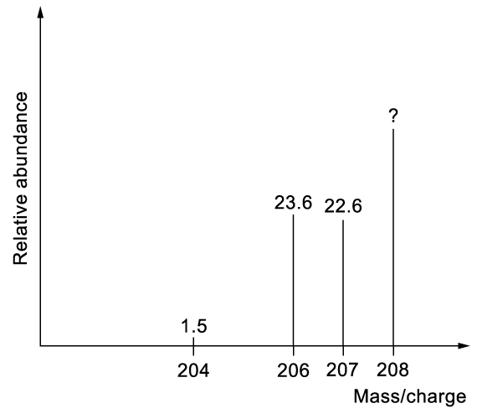
Hint slide No. :
(a) The mass spectrum of lead is given below. Given that the relative atomic mass of lead is 207.242, calculate the relative abundance of the peak at m/e of 208.
Let x be the relative abundance of the peak at m/e of 208.
(204 × 1.5 + 206 × 23.6 + 207 × 22.6 + 208x) ÷ (1.5 + 23.6 + 22.6 + x) = 207.242
x = 52.3
The relative abundance of the peak at m/e of 208 is 52.3.
Answer

Slide 80
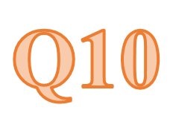
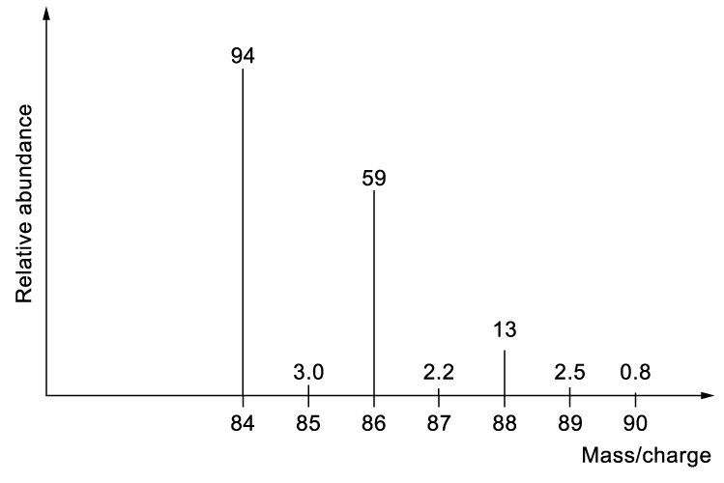
Hint slide No. :
Back
(b) The mass spectrum of dichloromethane is given below. Calculate the relative molecular mass of dichloromethane.
The relative molecular mass of dichloromethane
= (84 × 94 + 85 × 3.0 + 86 × 59 + 87 × 2.2 + 88 × 13 + 89 × 2.5 + 90 × 0.8) ÷ (94 + 3.0 + 59 + 2.2 + 13 + 2.5 + 0.8)
= 85.128
The relative molecular mass of dichloromethane is 85.128.
Answer

Slide 81
Lesson Objectives
List the relative charges and masses of protons, neutrons and electrons State that the atom has a dense, positively charged nucleus consisting of protons and neutrons, around which move negatively charged electrons. State that an element is identified by its atomic number (Z) which determines the number of electrons in a neutral atom of the element. Define the mass number (A) of an atom as the total number of protons and neutrons in the nucleus of an atom. From the relationship between atomic number and mass number, determine the number of protons, neutrons and electrons in an atom or monatomic ion. (can re-cap quick or do it in ionic bonding) Describe and explain the contributions of each of the following scientists to the development of the atomic model: Dalton Thomson Rutherford, Bohr Chadwick Draw labelled diagrams and explain the structure of each of the atomic models associated with the scientists listed above. Draw and label a timeline showing the development of the atomic model. Explain how changes in technology have contributed to the atomic model and our understanding of the atom.
Define isotopes as atoms with the same number of protons and different numbers of neutrons. Explain the existence of isotopes in terms of the neutron content of the nucleus. Give examples of isotopes that have similar chemical properties but different physical properties, such as hydrogen, carbon and cobalt. Describe differences in physical properties of isotopes of the same element, such as hydrogen, carbon and cobalt. Predict the chemical behaviour of an isotope given the properties of another isotope of the same element.- THERE AREN’T ANY JUST IT CAN BE RADIOACTIVE (DETECTABLE) OR THE SLIGHTLY HEAVIER. Define relative atomic mass (atomic weight) as the ratio of the average mass of the atom to 1/12 the mass of an atom of 12-C. Explain the existence of fractional atomic masses of some elements in terms of the existence of naturally occurring isotopes. You need to … Calculate the relative atomic mass given the isotopic mass and relative abundances of the isotopes of an element. Represent different isotopes in the form ^{A}X (IUPAC) or X-A. Calculate relative abundance of an isotope given relative atomic mass and abundance of other isotopes of an element. State and compare the characteristics of homogeneous and heterogeneous substances. Distinguish between pure substances (elements and compounds), homogeneous mixtures and heterogeneous mixtures. Explain the relationship between the identity and relative amounts of substances in a mixture and its properties.

